Slide 1
Analysing eCommerce behavior
From data exploration to modeling

Slide 2
Understanding eCommerce Behavior
Why this analysis is important
eCommerce is a rapidly growing industry.
Companies seek insights into user behavior for better decision-making.
Competitive advantage through data-driven strategies.
What we aim to achieve
Predict user purchases accurately.
Understand user interactions and preferences.
Identify actionable insights for business growth.

Slide 3
Who benefits from our analysis
eCommerce companies and retailers.
Marketing and sales teams.
Data analysts and scientists.
End-users for improved user experience.
Limitations of our study
Data availability and quality.
Resource and time constraints.

Slide 4
Problem formulation
Problem Type
Binary Classification: Predicting Purchases (1) or No Purchases (0).
Objective
Develop a model to understand and predict user purchase behavior based on user interactions.
Method
Utilize supervised machine learning algorithms for predictive analysis.

Slide 5
Dataset description
Dataset Overview
Kaggle Dataset: eCommerce Behavior Data from a Multi-Category Store.
Contains extensive user behavior data.
Features include event type, time, product details, and more.
Data Size : 67501979 rows, 9 columns.
Data Types: Numeric, Categorical, Datetime.
Data Sources: Acquired from an eCommerce platform.
Data Challenges
Data preprocessing required (e.g., handling missing values, encoding categorical data).

Slide 6
Preparing data for analysis
Data Wrangling Steps
Data Loading
Importing the dataset using Pandas.
Handling Missing Data
Identifying and dealing with missing values.
Data Cleaning
Removing duplicates.
Feature Engineering
Creating new features for analysis (e.g., purchases per session, views per session).
Encoding Categorical Data
Label encoding for categorical variables.
Standardization
Scaling numerical features for consistency.
Data Transformation
Converting datetime features.

Slide 7
Key Takeaways
Cleaned and prepared dataset for analysis.
Engineered features to enhance predictive power.
Ensured data consistency through encoding and scaling.
Transformed datetime features for analysis.

Slide 8
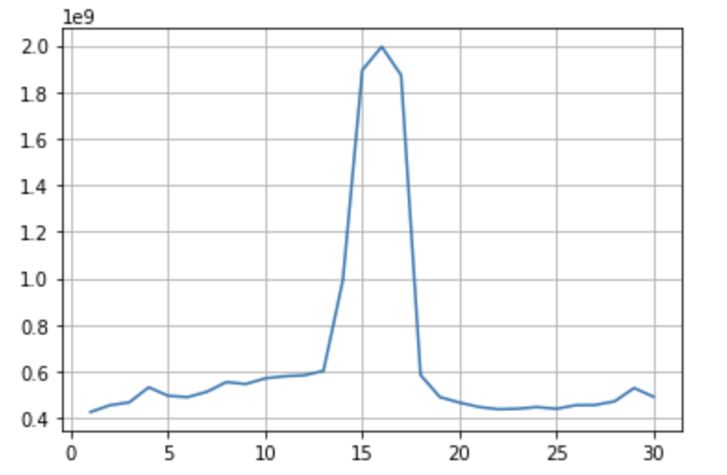
Exploratory analysis
Sales trend:
purchases ($) per day of
the month

Slide 9
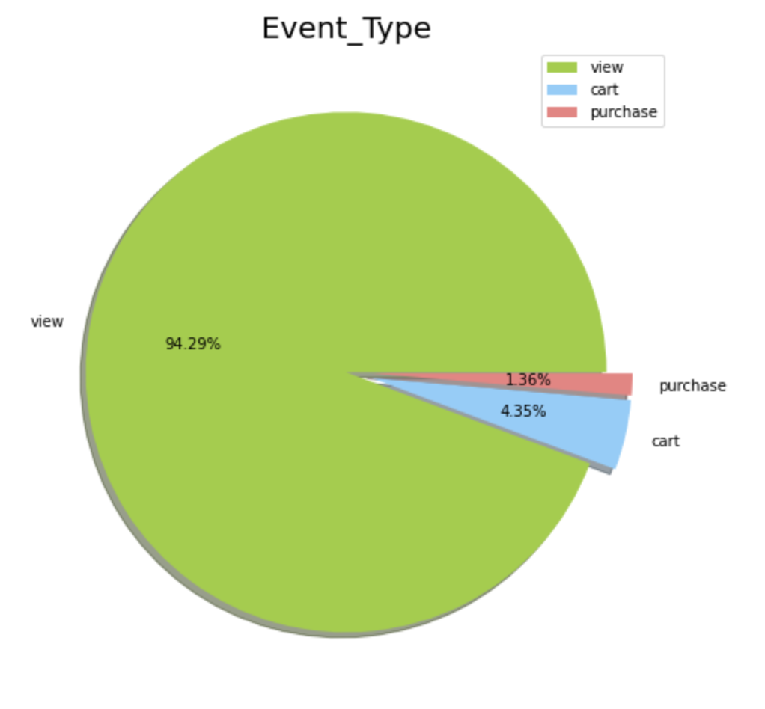
User activities

Slide 10
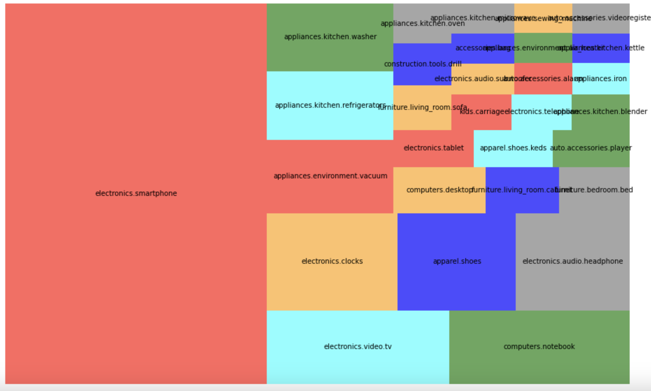
Product Categories

Slide 11
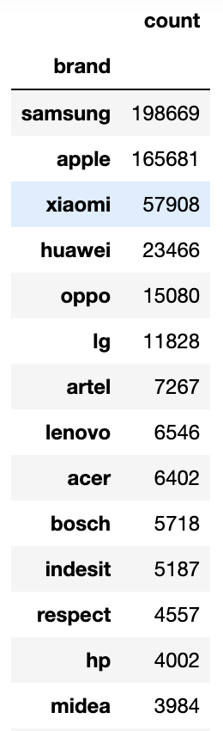
Brand preferences
Quantity of items of the most popular brands

Slide 12
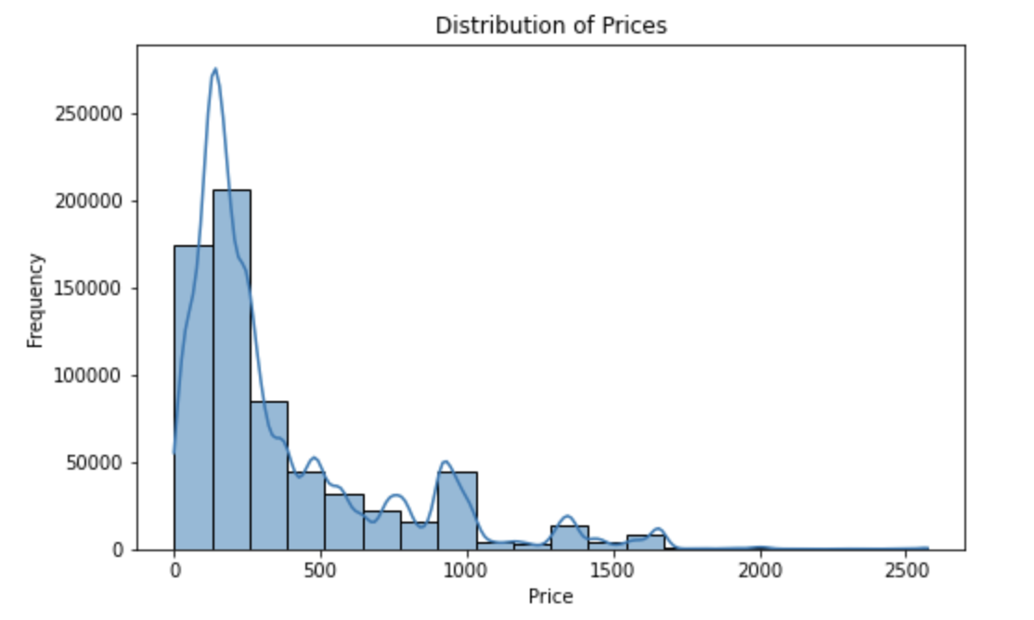
Price Distribution

Slide 13
Modeling process
Data Preprocessing
Data scaling and transformation.
Handling categorical variables.
Model Selection
Choosing appropriate algorithms (XGBoost, Logistic regression).
Model Training
Splitting data into training and testing sets.
Training models on the dataset.
Performance Metrics
Metrics used to evaluate model performance (Accuracy).

Slide 14
Reasons to choose XGBoost:
Handling Imbalanced Data
Accuracy
Feature Importance
Speed and Efficiency
Interpretability
Reasons to choose Logistic regression:
Interpretability
Simplicity
Efficiency
Low Variance
Well-Suited for Binary Classification

Slide 15
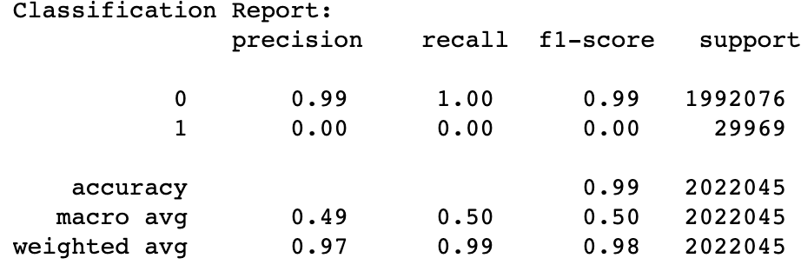
Performance Metrics

Slide 16
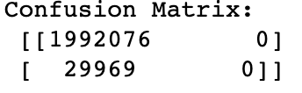
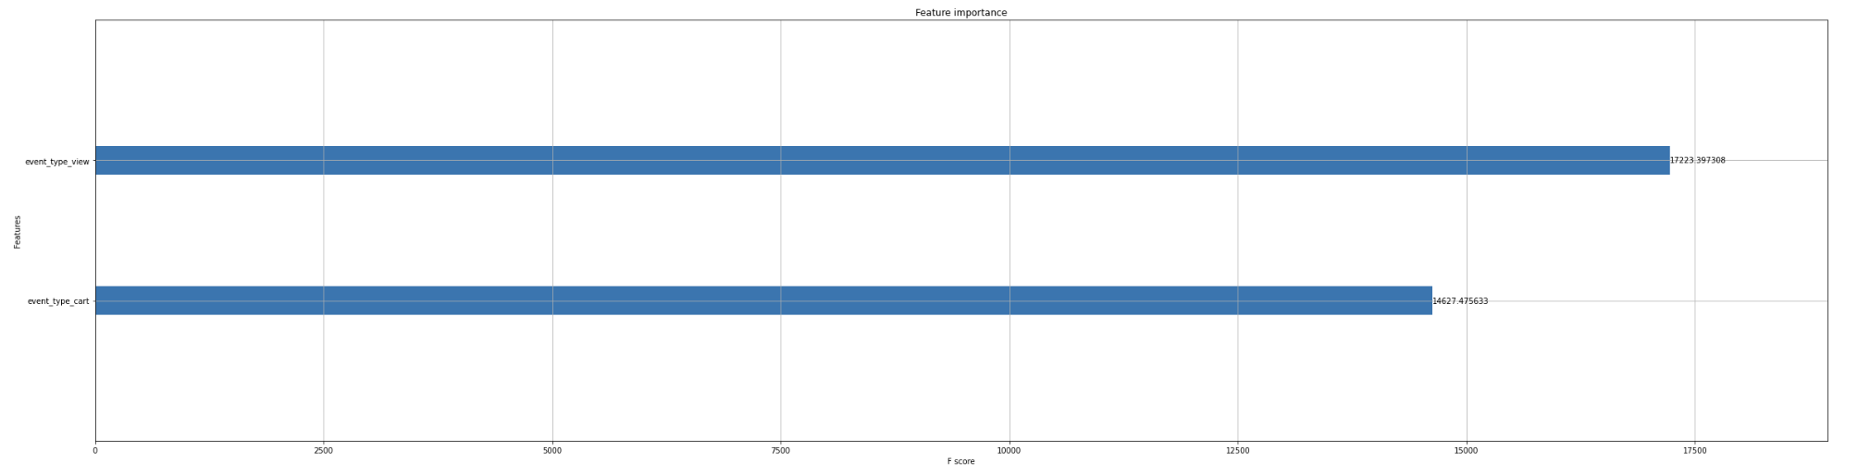
“View” and “Cart” features strongly influenced purchase decisions.

Slide 17
Practical considerations and future work
Scalability: Ensure that systems can handle larger datasets and increased computational demands as the business grows. Probably need to implement distributed computing, or data partitioning.
Real-time Analytics: If real-time insights are critical, invest in streaming data processing and real-time analytics tools. This allows for immediate responses to changing user behavior and market trends.
Cost Management: Keep an eye on the cost of maintaining and running machine learning models. Optimize cloud resources and consider cost-effective alternatives for storing and processing data.
User Experience (UX): Prioritize the user experience when implementing data-driven recommendations or marketing strategies. Ensure that recommendations are relevant and enhance the overall user journey.

Slide 18
Suggestions For Improvement
User Segmentation:
Explore user segmentation techniques to tailor marketing strategies more effectively. Identifying distinct user groups and customizing marketing approaches can lead to higher conversion rates.
Advanced Analytics:
Investigate advanced analytics methods such as deep learning or time series forecasting, especially if the dataset grows in complexity or if the business needs evolve.
Data Augmentation:
If more data is obtainable, consider data augmentation techniques to expand the dataset. Augmenting data can help the model generalize better and improve its predictive power.

